Slide 1

School of Information and Communication Technology
Project I
TCP FILE TRANSFERRING SYSTEM
Instructor: Tong Van Van .PhD
Authors:
Nguyễn Nghĩa Hà - 20225570
Phạm Đặng Tấn Dũng - 20225569

Slide 2
Introduction
The TCP File Transferring System is a Java-based web application designed to streamline the process of uploading and downloading digital files within a networked environment. It provides a dependable and user-friendly solution, serving both businesses and individual users.​
Users have the option to log in to their personal accounts for file management. If a user doesn’t have an account yet, they can sign up to create one. Once logged in, users can perform actions such as uploading, downloading, and deleting files. The files are organized in alphabetical order for easy management.

Slide 3
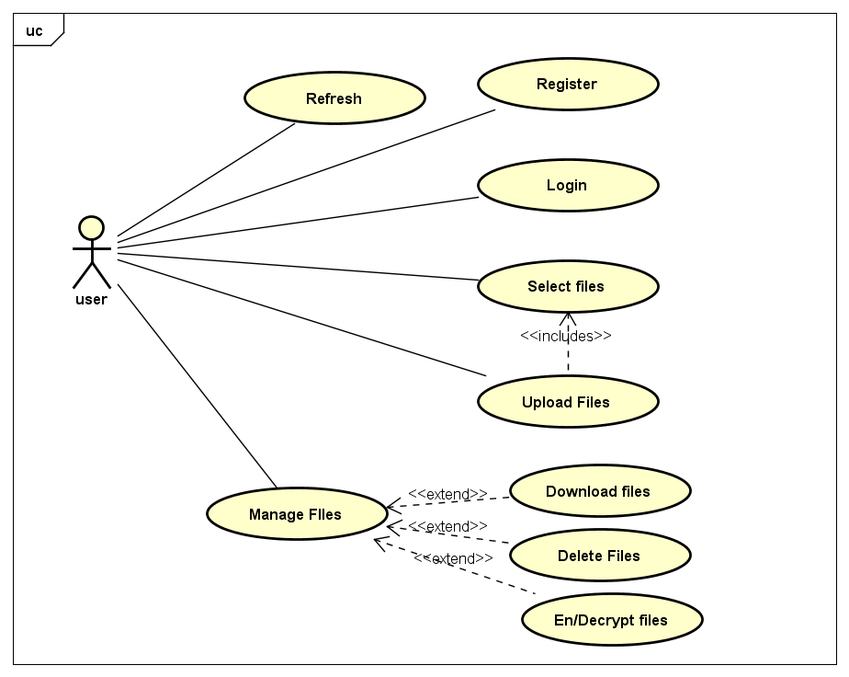
Use case Diagram

Slide 4
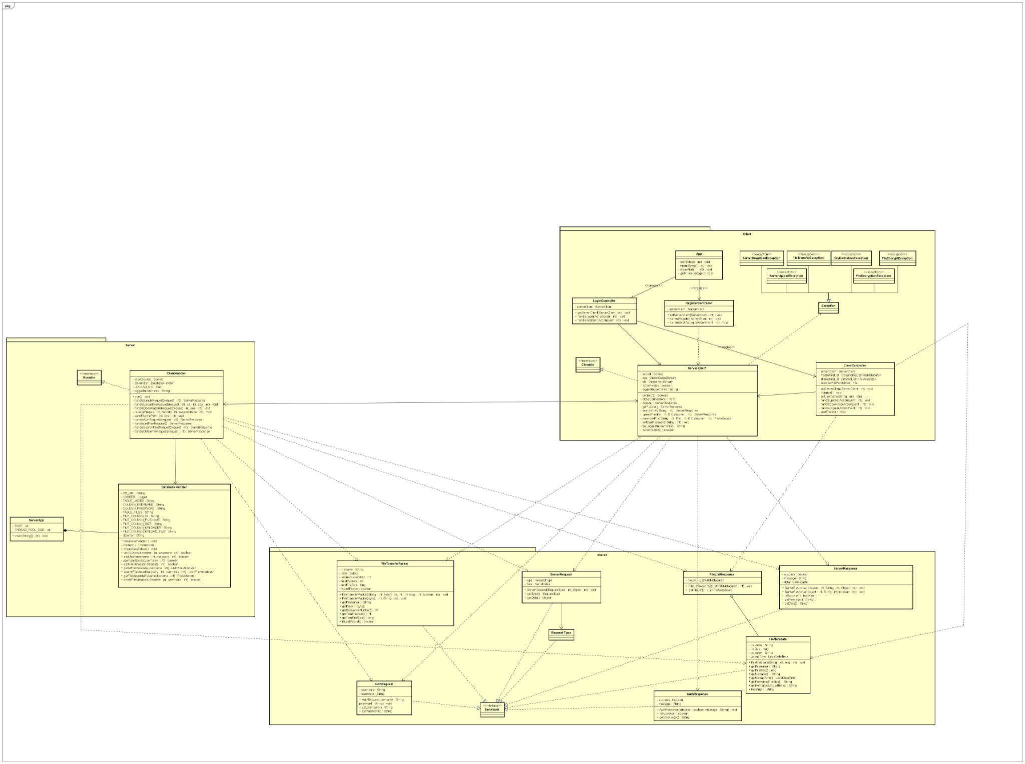
Class Diagram

Slide 5
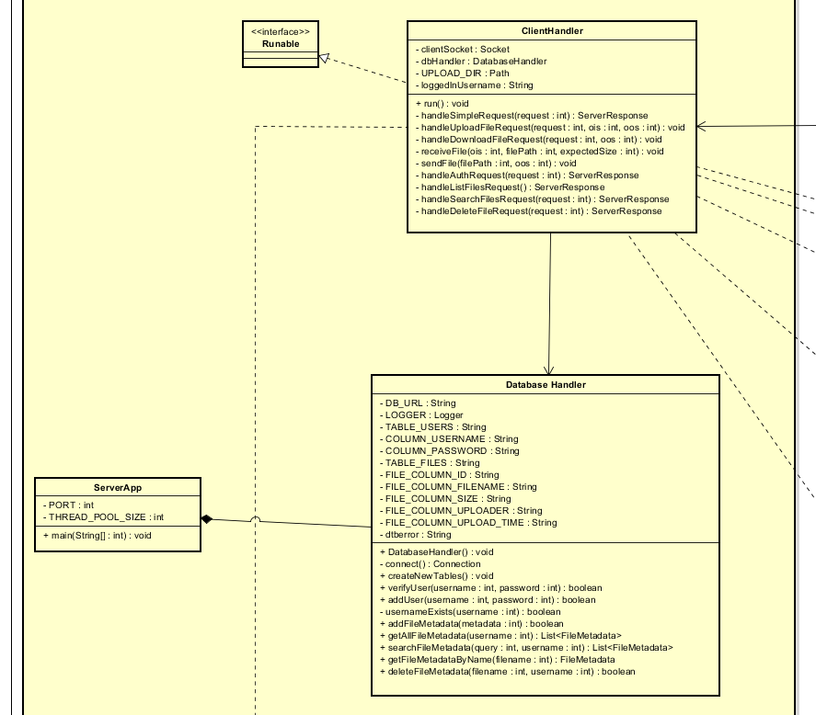
Server (The Backend)
Server: Responsible for listening to connections, authenticating users, and storing encrypted files.
ServerApp: Entry point that creates a ServerSocket to listen for connections and a ThreadPool to handle multiple clients concurrently. It also owns the DatabaseHandler.
ClientHandler: Created for each connected client in a separate thread. Responsible for reading requests, processing them, and sending responses.
DatabaseHandler: Handles all interactions with the SQLite database, including user info (username, password) and file metadata (name, size, uploader, etc.).

Slide 6
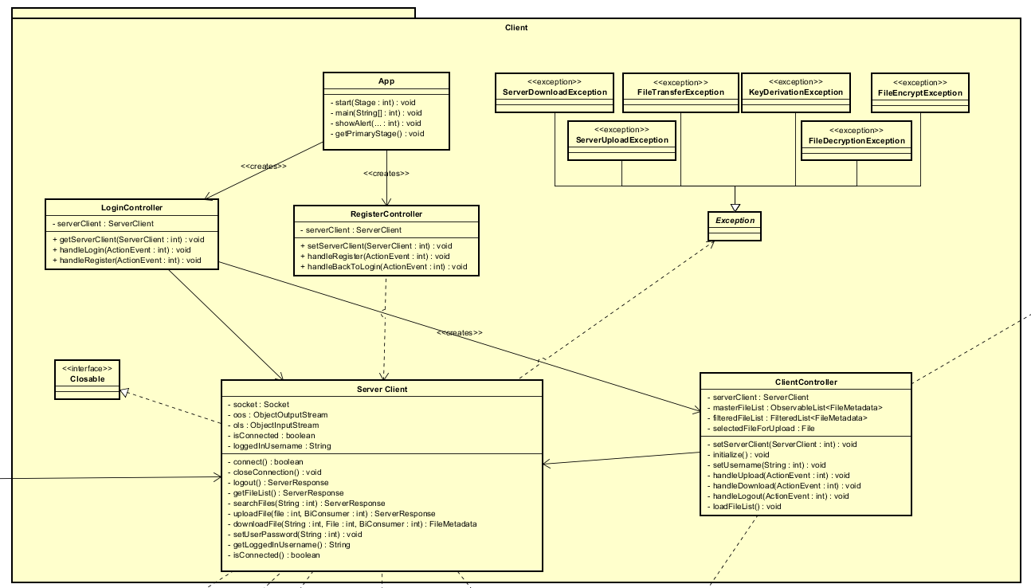
Client (The Frontend)
Client: The graphical user interface (JavaFX) that the user interacts with.
- App: Entry point of the client application, responsible for loading the initial UI (Login screen). - LoginController & RegisterController: Handle logic for login and registration screens. - ClientController: Core controller for the main screen, managing all post-login actions like displaying files, searching, uploading, and downloading. - ServerClient: The client’s “ambassador,” encapsulating all networking logic. All requests to the server and response handling go through this class. It also handles file encryption and decryption.

Slide 7
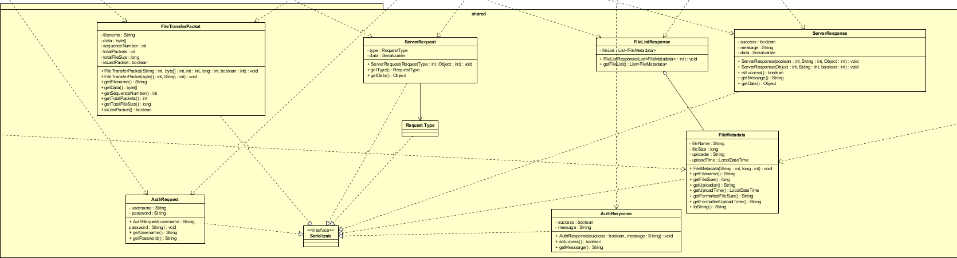
shared (The Common Language)
Shared: Contains object classes used by both the client and server for communication. This is the system’s “common language” or protocol.
ServerRequest & ServerResponse: Encapsulate all requests and responses.
FileMetadata, AuthRequest, etc.: Data Transfer Objects (DTOs) for specific types of requests.

Slide 8
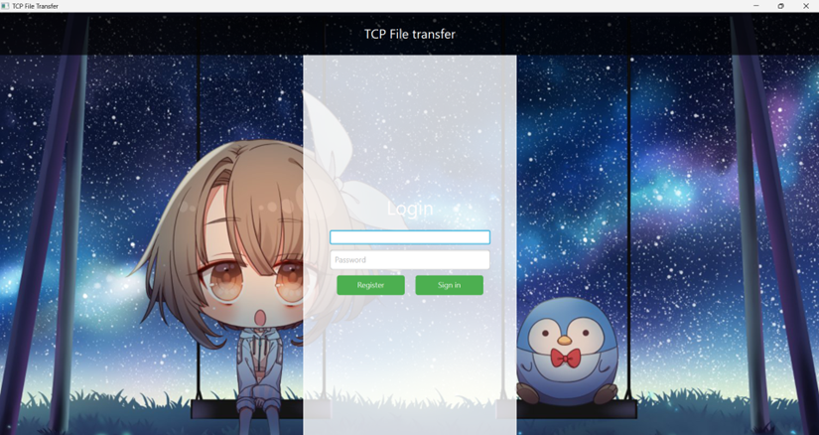
Explanation of the Demo
Login view

Slide 9
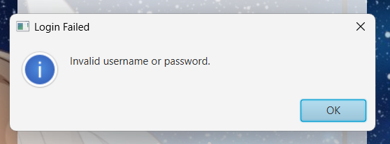
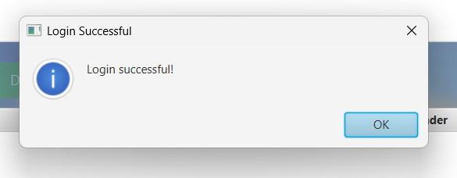
Login
If the username or password is incorrect, the system will display “Invalid usename or password”.
If your email and password are both correct, the server will return the message: “Login successfull” and get you to the home screen.

Slide 10
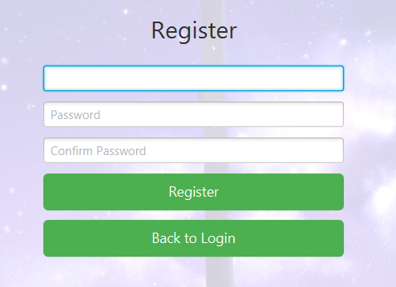

Register
If you don't have an account, you can click the Register button and proceed with the registration.

Slide 11
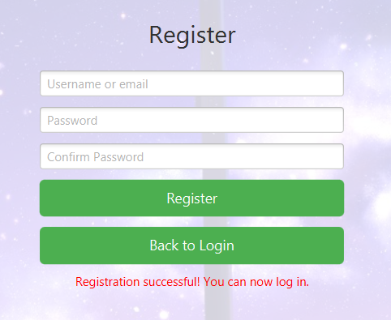
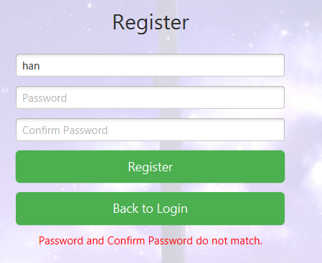
Register
If you successfully register, the system will display a massage” Registration successfully. You can now log in”
If the passwords do not match, the system will display an error.

Slide 12
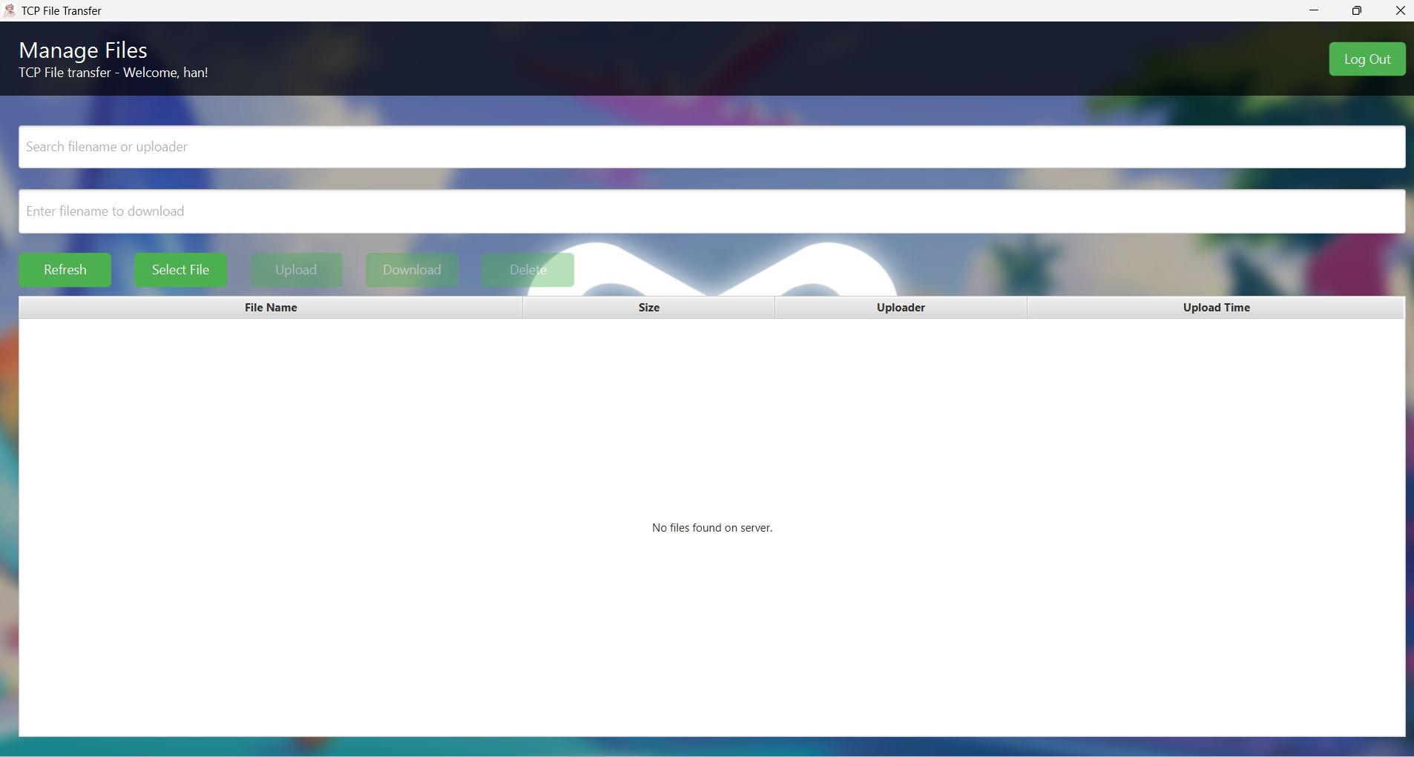
Explanation of the Demo
Home Screen

Slide 13
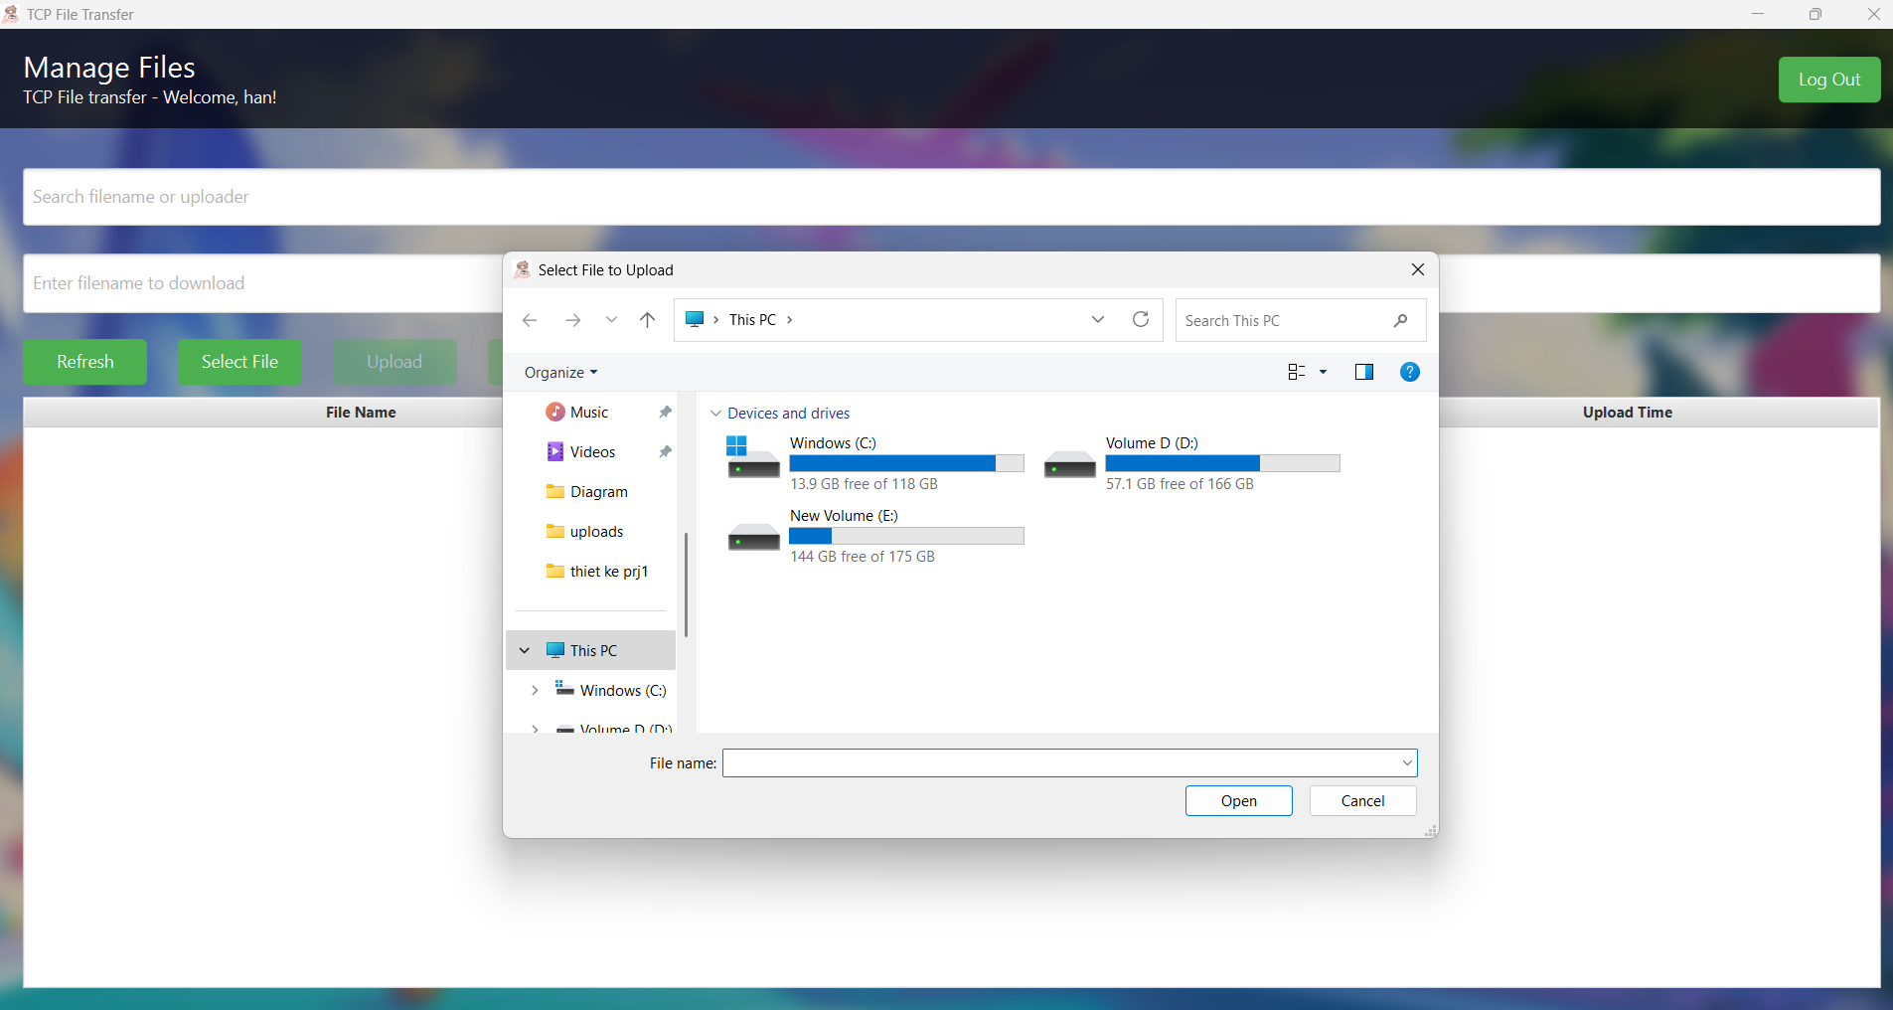
Explanation of the Demo
When you click the ‘Sellect Files' button, the system will open the File Explorer on your local machine. It allows you to select a file and upload it to the system."

Slide 14
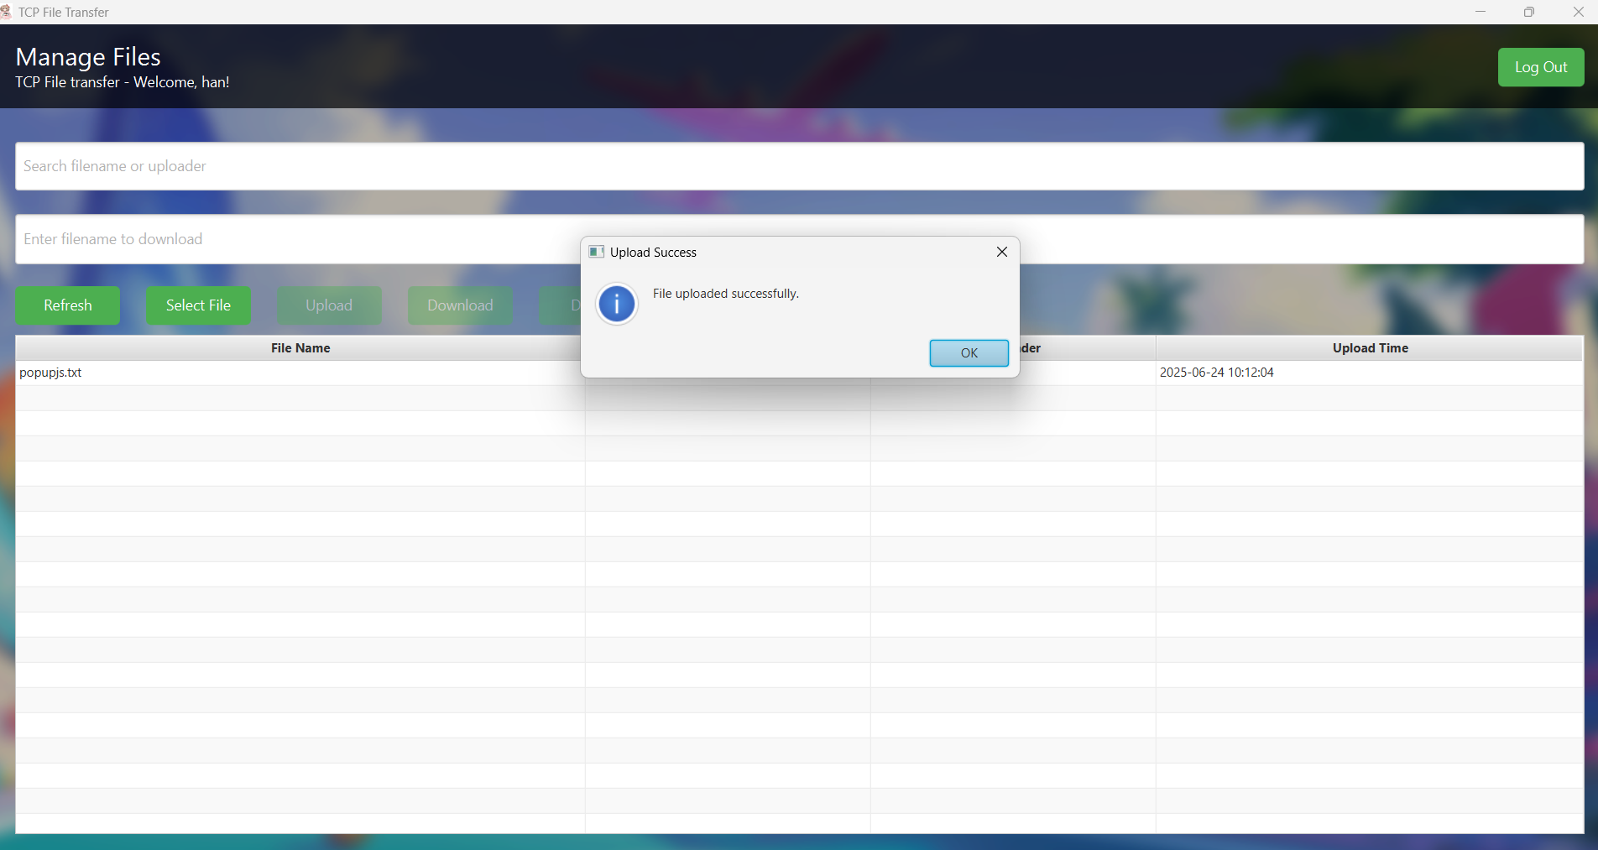
Explanation of the Demo
The file has been uploaded and appears on the main screen of the system.

Slide 15
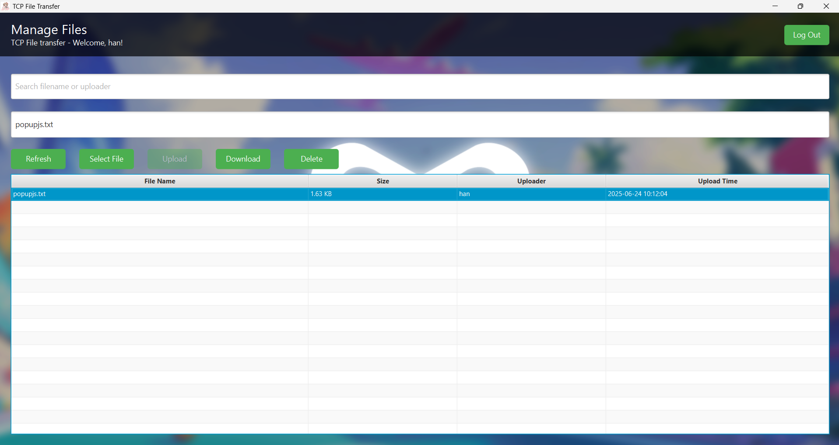
Explanation of the Demo
When we click on a file displayed on the system's main screen, the Delete and Download buttons will become active, allowing us to perform those actions on the file.

Slide 16
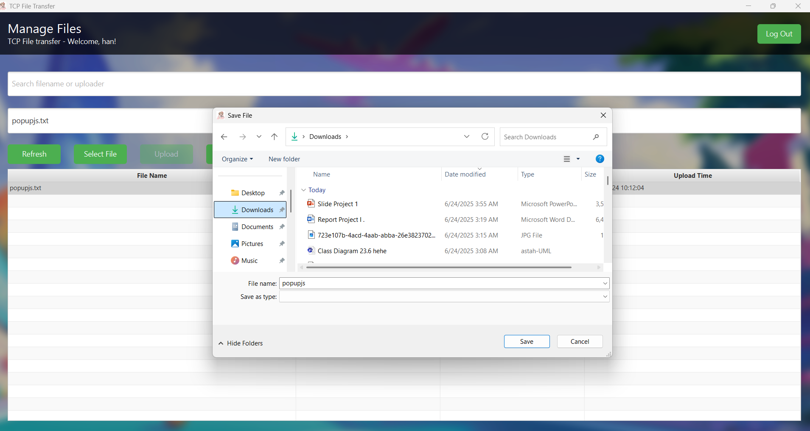
Explanation of the Demo
When you select Download, the system will open your computer's File Explorer, allowing you to choose the destination folder.

Slide 17
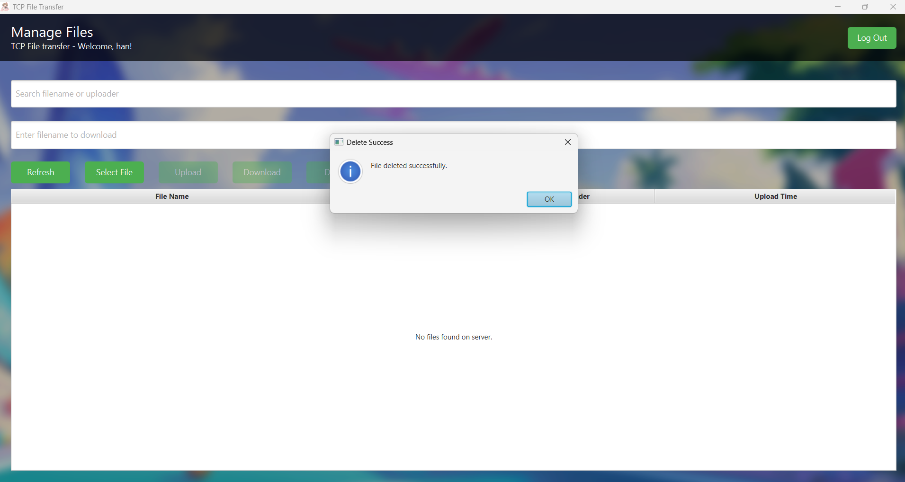
Explanation of the Demo

Slide 18
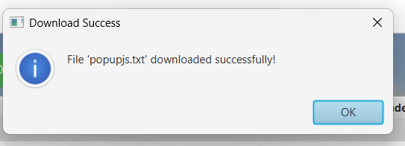
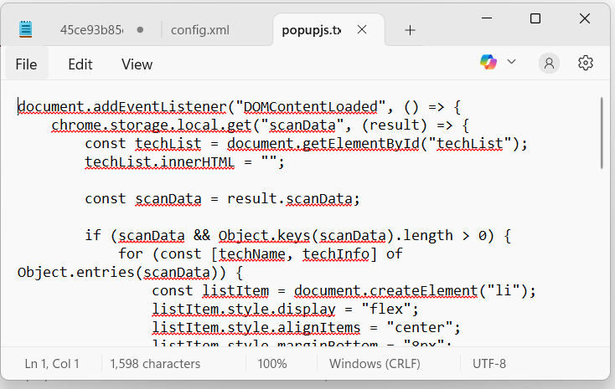
Explanation of the Demo
The file is encrypted before being uploaded to prevent anyone, including the admin, from viewing its contents. It will be decrypted after downloading, allowing you to view the file normally.

Slide 19


Explanation of the Demo

Slide 20
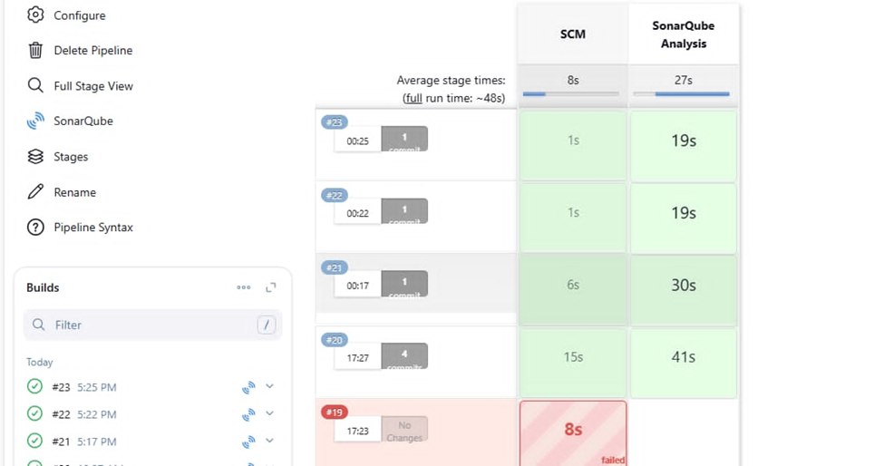
SonarQube in Pipeline CI/CD
Automated code quality check using SonarQube
Pipeline consists of two stages: SCM and SonarQube Analysis
Average runtime per execution: ~48 seconds
Stable build process with mostly successful runs

Slide 21
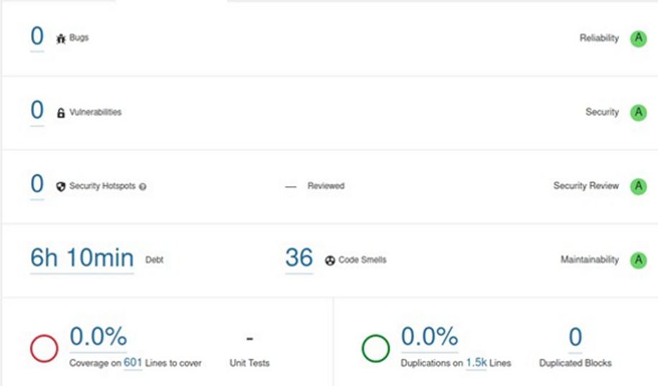
Source Code Quality Overview
0 Bugs, 0 Vulnerabilities, 0 Security Hotspots
36 Code Smells, estimated technical debt: 6 hours 10 minutes
All quality indicators are rated A (the highest grade)

Slide 22
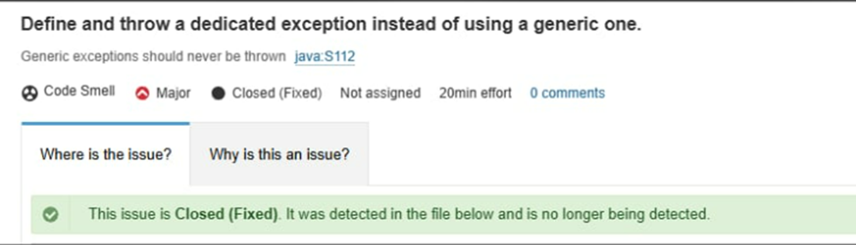
Code Smell
Issue: Use of generic exception (java:S112)
Type: Major Code Smell
Status: Resolved
Impact: Improved code clarity and maintainability

Slide 23
Conclusion
The TCP File Transferring System fully meets the requirements for secure file transmission and management between the client and server over TCP. It ensures security, ease of use, and scalability for practical applications.

Slide 24
References
1. CD Foundation. Jenkins. https://www.jenkins.io/.
2. Openjfx. JavaFX. https://openjfx.io/.
3. GluonHQ. Scene Builder. https://gluonhq.com/products/scene-builder/.
4. SonarSource. Sonarqube. https://www.sonarsource.com/products/sonarqube/.
5. The Apache Software Foundation. Maven. https://maven.apache.org/.
6. Astah. https://astah.net/products/astah-community/.

Slide 25
THANK YOU !

